Slide 1
Teaching the new A Levels: Dr Nick Dixon

Slide 2
Course structure: Previously: January and June exams and so resits were allowed Now: Both courses (AS and A2) are linear with no January exams and so no resits Additionally the courses have been ‘decoupled’ so AS is stand-alone Implications: We now only offer A2 not AS

Slide 3
Examinations: The overall time is the same (six hours) Previously: A2 Biology was four exams over two years (80%) and two internal assessments (20%) Now: Three exams at end of two years (100%) Implications: More time during course, a better ‘flow’ and focus on longer term understanding

Slide 4
The practical activities: Now: Exam questions will ask students to design experiments, improve methods, process results and draw conclusions. Implications: 1. We are now doing more practical work 2. This is more student-led 3. This is also more targeted 4. More focussed work on exam questions

Slide 5
Practical endorsement: Previously: Two pieces of internal assessment which made up 20% of total A2 grade Now: Twelve required practicals which make up 15% of total A2 marks (through exam questions). All students must complete a laboratory book. These are teacher-assessed and lead to a pass on students’ certificates (or a fail). All schools will be visited by Exam Board ‘advisors’

Slide 6
The five competencies: 1. Follows written procedures 2. Applies investigative approaches and methods when using instruments and equipment 3. Safely uses a range of practical equipment and materials 4. Makes and records observations 5. Researches, references and reports

Slide 7
The practical activities: 1. Investigation into the effect of a named variable on the rate of an enzyme-controlled reaction 2. Preparation of stained squashes of cells from plant root tips 3. Production of a dilution series of a solute to produce a calibration curve 4. Investigation into the effect of a named variable on the permeability of cell-surface membranes 5. Dissection of animal or plant gas exchange or mass transport 6. Use of aseptic techniques to investigate the effect of antimicrobial substances on microbial growth system or of organ within such a system

Slide 8
The practical activities: 7. Use of chromatography to investigate the pigments isolated from leaves of different plants 8. Investigation into the effect of a named factor on the rate of dehydrogenase activity in extracts of chloroplasts 9. Investigation into the effect of a named variable on the rate of respiration of cultures of single-celled organisms 10. Investigation into the effect of an environmental variable on the movement of an animal 11. Production of a dilution series of a glucose solution and use of colorimetric techniques to produce a calibration curve 12. Investigation into the effect of a named environmental factor on the distribution of a species

Slide 9
Ofqual research: “Ofqual is keen to ensure that changes to the way that practicals are assessed does not reduce the capabilities of students. Research is being carried out to evaluate the practical skills of new science undergraduates [before and after the change]. A bespoke practical skills measure will be deployed by independent assessors at universities… in Autumn 2016, 2017 and 2018.”

Slide 10
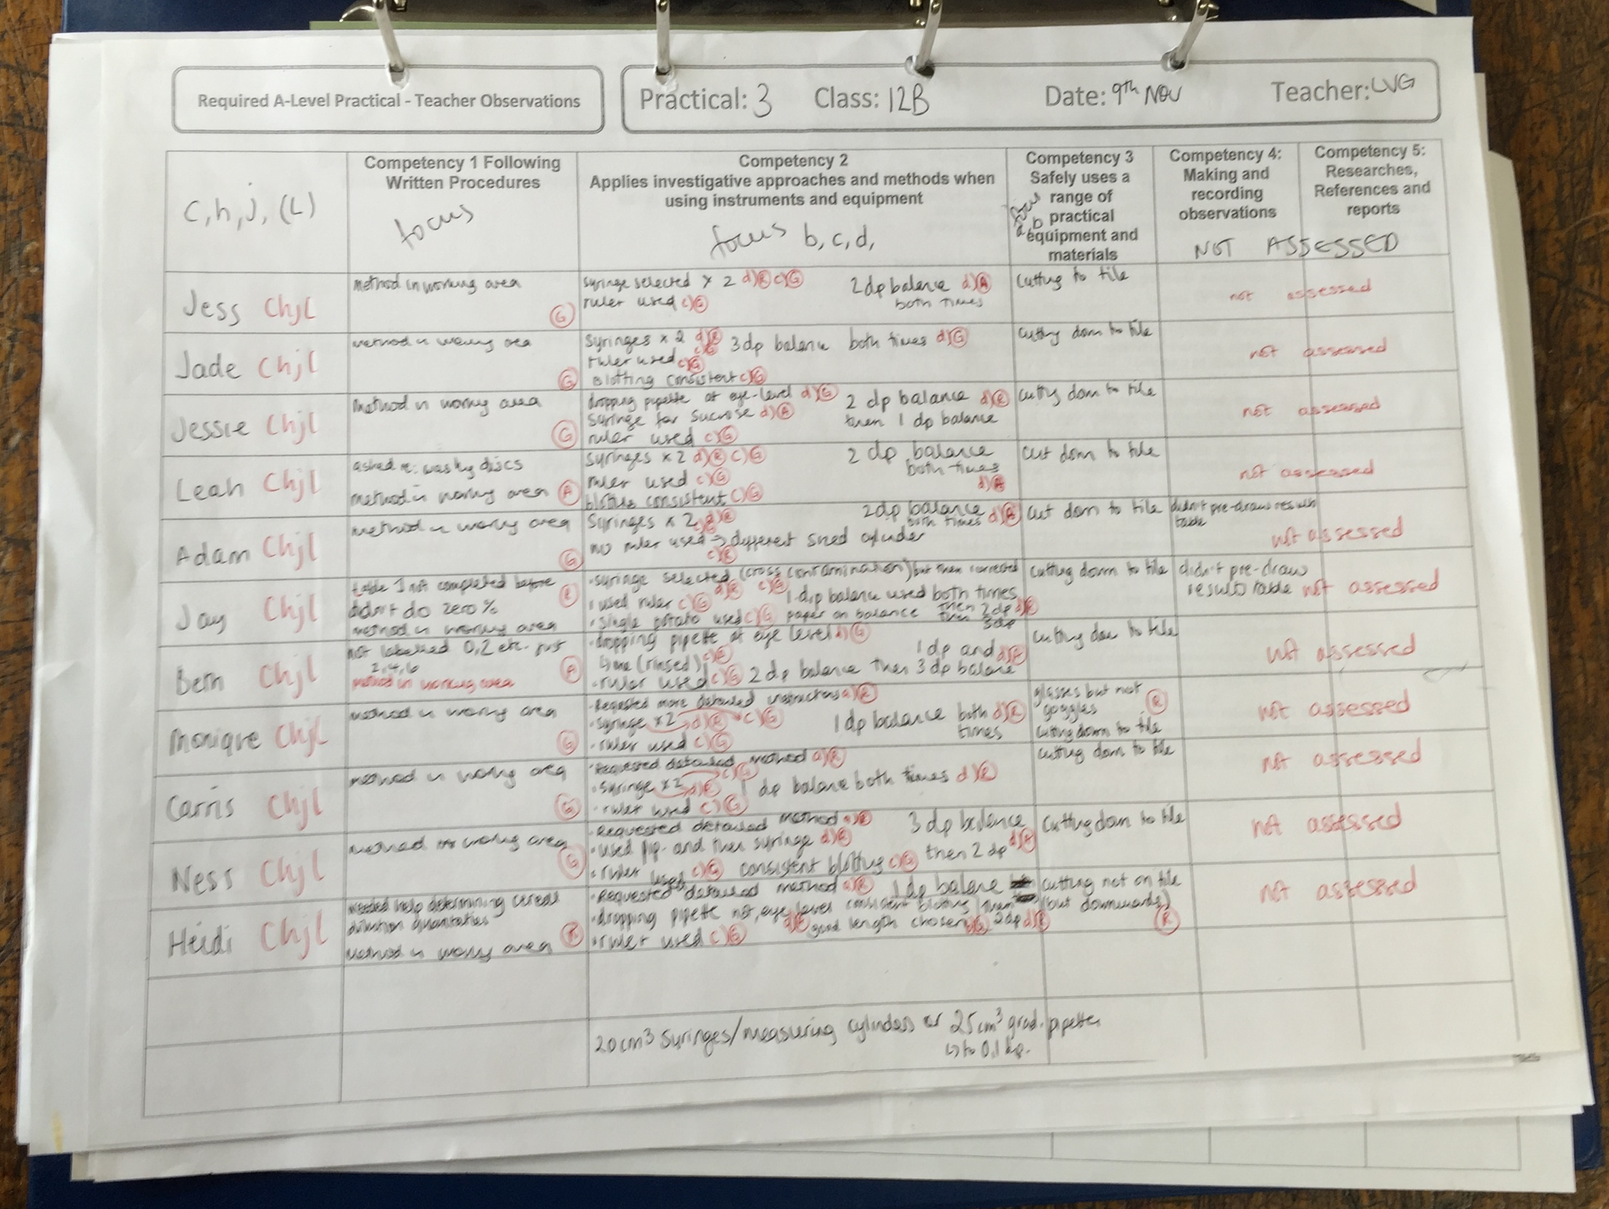
A practical book:

Slide 11
Content changes: What is new: water, inorganic ions, bonding in proteins, more detail about ATP, viruses, ELISA, calculating the mitotic index, translocation in plants, stabilising selection, species richness, carrying capacity, phosphorous cycle, dihybrid inheritance, nephron structure What is lost: disease, lock and key hypothesis, water uptake in plants, ecological pyramids, intensive farming, carbon cycle, global warming, thermoregulation

Slide 12
Mathematics in biology: There doesn’t seem to be much of a change. Ten percent of exam papers will test this. It will be equivalent to higher tier GCSE mathematics. It will cover: arithmetic and numerical computation, handling data, algebra, graphs, geometry and trigonometry

Slide 13
One of my Year 12 students said: “This year there is much more emphasis on retaining and then applying knowledge. My teachers pester me about keeping my notes neat and in order. The practicals are the most different. I feel I learn more by improving on the previous practical [not just being stand-alone]. I like my lab book!”

